Slide 1
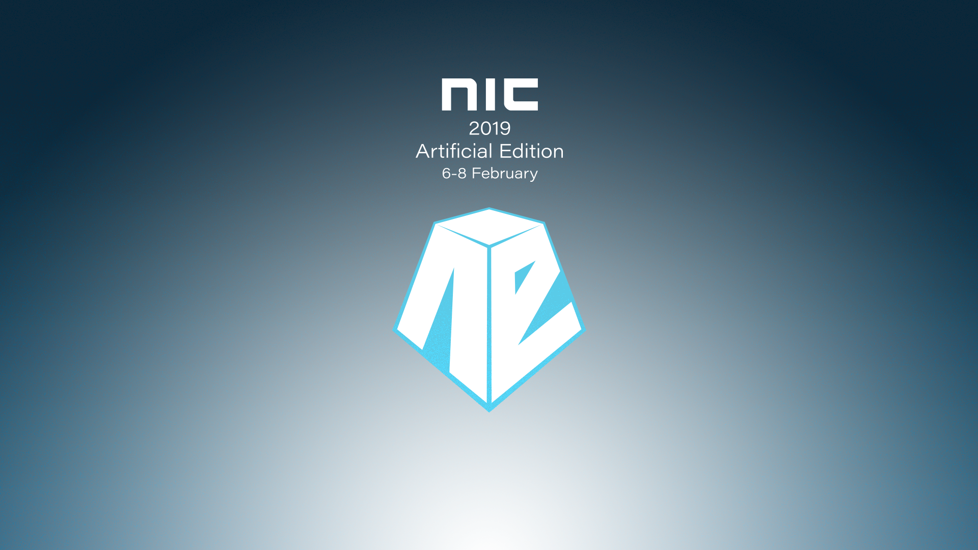

Slide 2

Extend ConfigMgr to the Cloud

Slide 3

Marius A. Skovli
CTGlobal Principal Consultant and Microsoft Enterprise Mobility MVP
mas@ctglobalservices.com @MariusSkovli

Slide 4

Kent Agerlund
CTGlobal Principal Consultant and Microsoft Enterprise Mobility MVP & Regional Director
kea@ctglobalservices.com @Agerlund

Slide 5

Agenda
Why cloud attach your environment?
Co-Management (ConfigMgr + Intune / Hybrid AAD join)
Cloud Management Gateway (CMG) and Cloud Distribution Point (CDP)
(OMS Connector)
(Upgrade Readiness)
(Microsoft Store for Business)

Slide 6
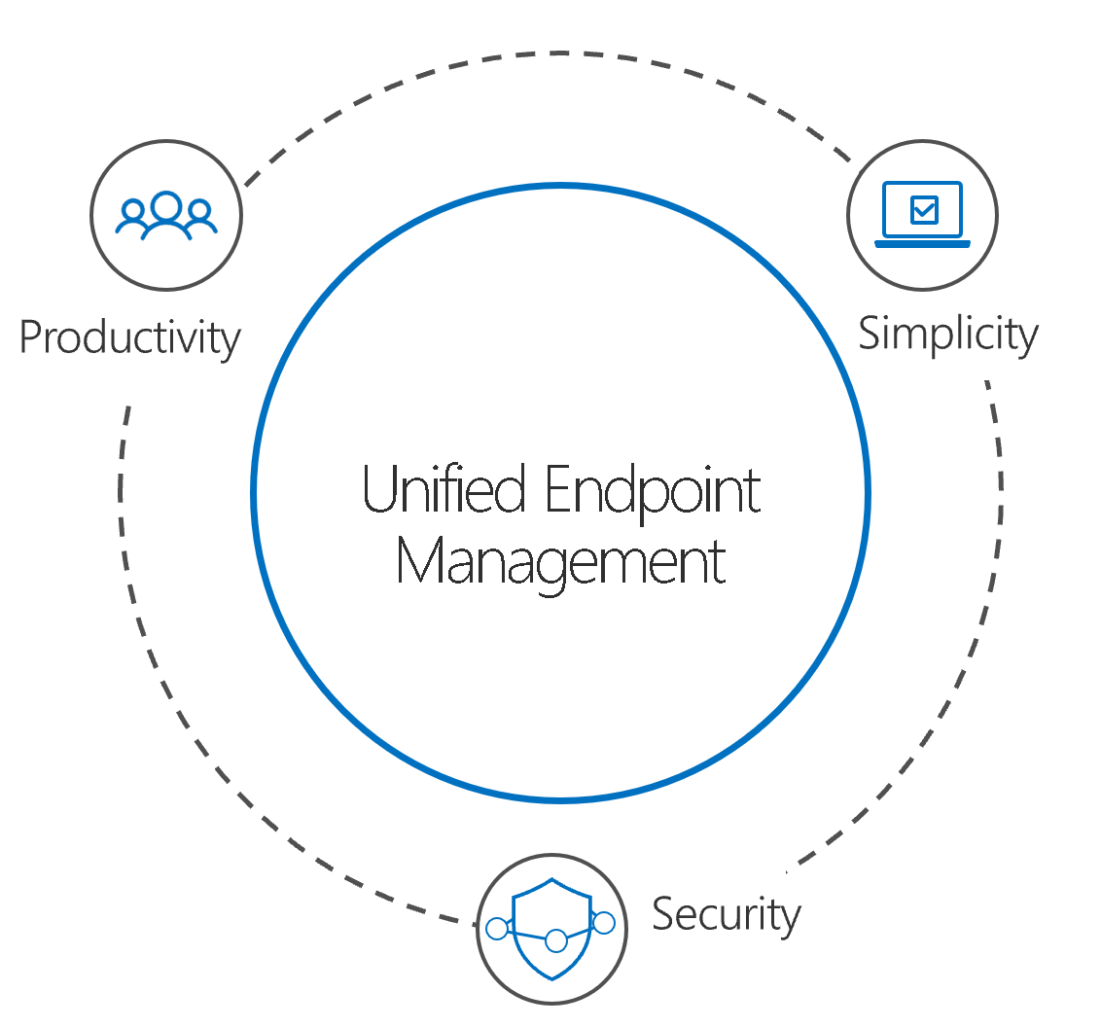
Why cloud-attach?

Slide 7
Getting Ready for Cloud Attach
ConfigMgr
ConfigMgr 1710+
Azure AD
Setup Hybrid Azure AD
Intune
If hybrid, migrate users off first
Standalone only
Windows client
Windows 10 1709+
License users for Azure AD
Enable Windows 10
Auto-enrollment
Set up Internet facing client
License users for Intune
Onboard to AAD

Slide 8


Internal
Existing processes and skillsets
Business
Enable productivity but make sure our company is protected
Employees
Give me tools that allow me to do my best work
External
Keeping up with new technology
IT is under Pressure to Transform

Slide 9
On-premises
The message from Microsoft
Modern Workplace
Legacy devices
Windows 7
Office
Active Directory
ConfigMgr
Windows Defender
Modern devices
Windows 10
Office 365
Azure Active Directory
Microsoft Intune
Microsoft Threat Protection
+
+
+

Slide 10
Management architectures: Cloud only
Intune & Azure
Active Directory
Cloud Modern Management

Slide 11
Management architectures: On-prem only
AD & ConfigMgr
Device Compliance
Patching
Software Distribution
On-premises

Slide 12
Management architectures: Co-managed
AD & ConfigMgr
Device Compliance
Patching
Software Distribution
Intune & Azure
Active Directory
On-premises
Cloud Modern Management

Slide 13




Windows 10 Modern Management Architecture
ConfigMgr
PowerShell
Microsoft Intune
OMA-DM Client
WMI Bridge
Configuration Service Providers

Slide 14

Transitioning to modern management
Adopt & Connect
Transition to Modern
ConfigMgr DPs to cloud content delivery
Win32 to modern apps
Traditional to modern authentication
GPO to MDM policy
Imaging to AutoPilot
WSUS to WUfB
Modernizing with co-management (ConfigMgr+AD and Intune+Azure AD)
Adopt Windows 10
Adopt Office 365 ProPlus
AD/Azure
AD Connect
Today

Slide 15
Benefits
Conditional access with device compliance
Intune-based remote actions, for example: restart, remote control, or factory reset
Centralized visibility of device health
Link users, devices, and apps with Azure Active Directory (Azure AD)
Modern provisioning with Windows Autopilot
Remote actions
Application deployment
Advanced Inventory

Slide 16
How to get to co-management
ConfigMgr agent
Intune MDM
AD Domain Joined
AAD Joined
ConfigMgr agent
AD Domain Joined
AAD Joined
ConfigMgr agent
AD Domain Joined
Existing ConfigMgr managed devices
AutoPilot
Intune MDM
AD Domain Joined
AAD Joined
ConfigMgr agent
Intune MDM
AD Domain Joined
AAD Joined
Modern Provisioning

Slide 17







Co-management before a workload transition
ConfigMgr
Console
Azure AD
ConfigMgr
Site Servers
MDM
Intune
MDM
ConfigMgr agent
Mobile Devices
Windows 10
Domain-joined & Azure AD registered
ConfigMgr agent
Windows 7/8.x

Slide 18
Co-management after a workload transition
ConfigMgr
Console
Azure AD
ConfigMgr
Site Servers
MDM
Intune
MDM
ConfigMgr agent
Mobile Devices
Windows 10
Domain-joined & Azure AD registered
ConfigMgr agent
Windows 7/8.x

Slide 19
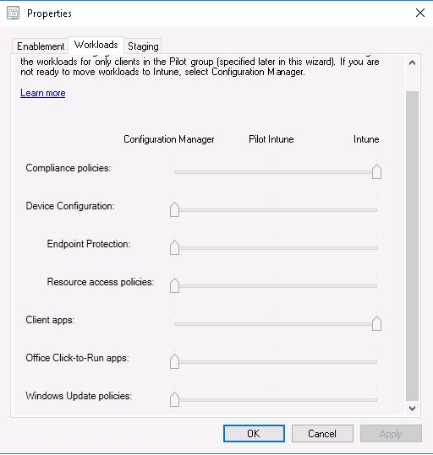
Workloads
Compliance policies
Conditional Access
Windows Update policies
WUfB
Device configuration
Configuration Baseline?
Endpoint Protection
*.Windows Defender
Resource access policies
VPN, WiFi. Email and certificates
Office Click-to-Run apps
Global Condition
Client apps
Software Center vs. Company Portal

Slide 20
Demo Co-Management

Slide 21
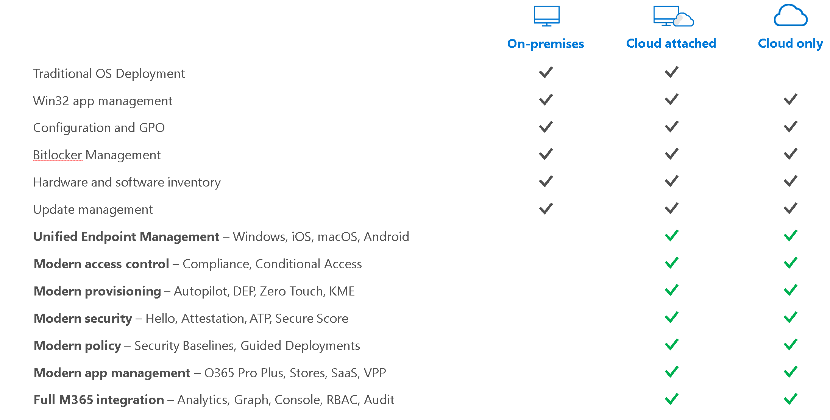
Why cloud-attach?

Slide 22
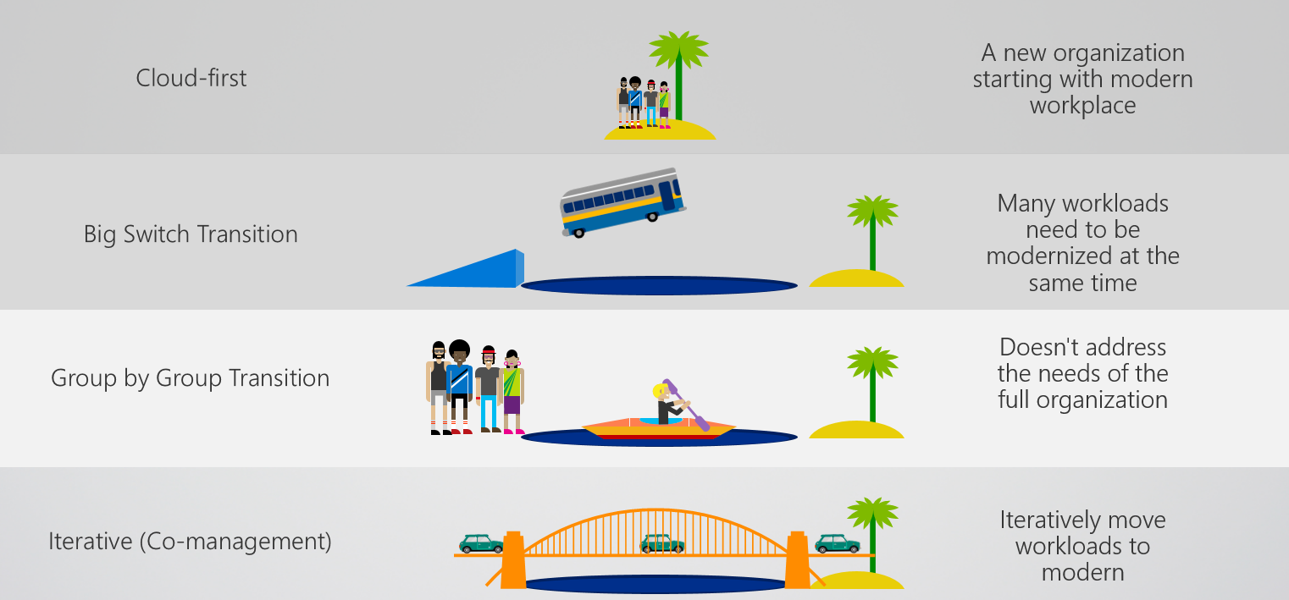
Why cloud-attach?

Slide 23
Paths to co-management (entrypoints)
Existing Configuration Manager clients (domain joined devise):
New internet-based devices (Azure AD + Intune managed devices):
You have Windows 10 devices that are already Configuration Manager clients. You set up hybrid Azure AD, and enroll them into Intune.
You have new Windows 10 devices that join Azure AD and automatically enroll to Intune. You install the Configuration Manager client to reach a co-management state.

Slide 24
Prerequisites (must have)
Licensing
Configuration Manager
Azure Active Directory Premium
Microsoft Intune
Windows 10
Azure AD Premium EMS/Intune
1710 or later
MDM Autoenrollment enabled
MDM Authority set to Intune
1709 or later

Slide 25
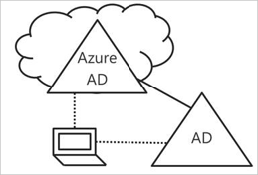
Prerequisites (must have)
Prerequisites (Domain joined devices)
Hybrid Azure AD Join
Windows 10 Devices joined to both AD and AAD
(Cloud Management Gateway)
Prerequisites (Azure AD joined devices)
Cloud Management Gateway

Slide 26
Extending the perimeter of ConfigMgr
Windows Update
Corporate Network
DMZ
Internet
AD
CA
MP
Azure
Site
DP
SUP
Firewall
Firewall

Slide 27
Internet-based Client Management
Windows Update
Corporate Network
DMZ
Internet
AD
CA
MP
AD
CA
Azure
Site
DP
MP
SUP
DP
SUP
Firewall
Firewall

Slide 28
Cloud Management Gateway
Windows Update
Corporate Network
DMZ
Internet
AD
CA
MP
Azure
Site
DP
Outbound port 443
CMG
CDP
Applications
Packages
3rd party updates
CMG Connection Point
SUP
Logical data flow
Firewall
Firewall

Slide 29
Prerequisites
An Azure subscription to host the CMG.
At least one on-premises Windows server to host the CMG connection point.
The service connection point must be in online mode.
A server authentication certificate for the CMG.
(If using the Azure classic deployment method, you must use an Azure management certificate.)
Other certificates may be required, depending upon your client OS version and authentication model.
Integration with Azure AD may be required for Windows 10 clients.
Clients must use IPv4.

Slide 30
Prerequisites
You can manage with one (1) certificate and that can be wildcard from vendor
PKI can be avoided

Slide 31
Demo Cloud Management Gateway Windows 10 device AAD Joined and Hybrid AAD Joined

Slide 32
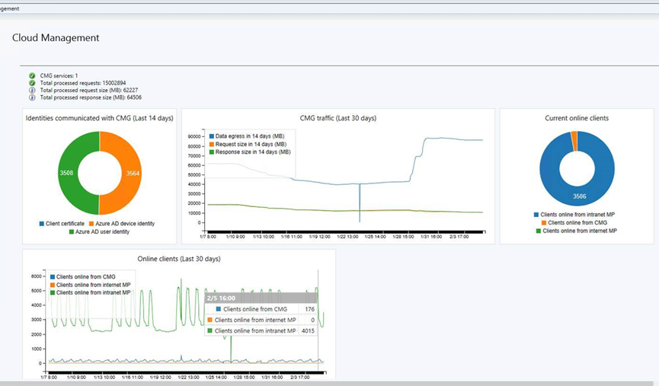
Cost
https://azure.microsoft.com/en-us/pricing/calculator/
Virtual Machines (A2 V2 VM)
Network (Bandwidth)

Slide 33
A few simple tips
On Domain joined devices after Azure AD join, the MDM Autoenrollment (could) take a long time
Configure Local or Global MDM Autoenrollment Policy
Use WMIExplorer to verify settings from Intune MDM (OMA-DM / OMA-URI)
Use Eventviewer to monitor MDM actions
Use CCM\Logs to monitor ConfigMgr agent actions
Use built in reports tool (Advanced Diagnostics Report)
Azure logs / Intune diagnostics
https://docs.microsoft.com/nb-no/sccm/comanage/overview

Slide 34
Slides and demos from the conference will be available at
https://github.com/nordicinfrastructureconference/2019

